Slide 1
THE THEORY OF PRODUCTION
Production involves transformation of inputs such as capital, equipment, labor, and land into output - goods and services
Inputs are considered variable or fixed depending on how readily their usage can be changed

Slide 2
THE THEORY OF PRODUCTION
Fixed input
An input for which the level of usage cannot readily be changed.
In economic sense, a fixed input is one whose supply is inelastic in the short run.
In technical sense, a fixed input is one that remains fixed (or constant) for certain level of output.

Slide 3
THE THEORY OF PRODUCTION
Variable input
A variable input is one whose supply in the short run is elastic, example, labour, raw materials, and the like. Users of such inputs can employ a larger quantity in the short run.
Technically, a variable input is one that changes with changes in output.
In the long run, all inputs are variable.

Slide 4
THE THEORY OF PRODUCTION
In this production process, the manager is concerned with efficiency in the use of the inputs
Technical efficiency vs. Economical efficiency

Slide 5
Two Concepts of Efficiency
Economic efficiency:
  occurs when the cost of producing a given output is as low as possible
Technological efficiency:
  occurs when it is not possible to increase output without increasing inputs

Slide 6
You will see that basic production theory is simply an application of constrained optimization:
the firm attempts either to minimize the cost of producing a given level of output
or
to maximize the output attainable with a given level of cost.
Both optimization problems lead to same rule for the allocation of inputs and choice of technology

Slide 7
Production Function
A production function is purely technical relation which connects factor inputs & outputs.
It describes the transformation of factor inputs into outputs at any particular time period.
Q = f( L,K,R,L_{d},T,t)
  where
  Q = output R= Raw Material
  L= Labour L_{d} = Land
  K= Capital T = Technology
  t = time
For our current analysis, let’s reduce the inputs to two, capital (K) and labor (L):
Q = f(L, K)

Slide 8
Short-Run and Long-Run Production
In the short run some inputs are fixed and some variable
  e.g. the firm may be able to vary the amount of labor, but cannot change the amount of capital
  in the short run we can talk about factor productivity / law of variable proportion/law of diminishing returns

Slide 9
In the long run all inputs become variable
  e.g. the long run is the period in which a firm can adjust all inputs to changed conditions
  in the long run we can talk about returns to scale

Slide 10
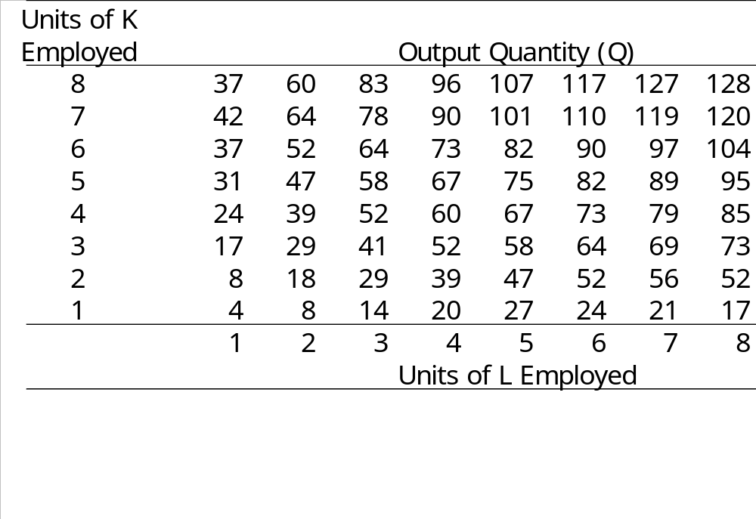
Short-Run Changes in Production
Factor Productivity
How much does the quantity of Q change, when the quantity of L is increased?

Slide 11

Long-Run Changes in Production
Returns to Scale
How much does the quantity of Q change, when the quantity of both L and K is increased?

Slide 12
Relationship Between Total, Average, and Marginal Product: Short-Run Analysis
Total Product (TP) = total quantity of output
Average Product (AP) = total product per total input
Marginal Product (MP) = change in quantity when one additional unit of input used

Slide 13
The Marginal Product of Labor
The marginal product of labor is the increase in output obtained by adding 1 unit of labor but holding constant the inputs of all other factors
Marginal Product of L:
MP_{L}= ΔQ/ΔL (holding K constant)
= δQ/δL
Average Product of L:
AP_{L}= Q/L (holding K constant)

Slide 14
Marginal Utility and Marginal Product
In Consumer Theory, marginal utility was the slope of the total utility curve
In Production Theory, marginal product is the slope of the total product curve:

Slide 15
Law of Diminishing Returns
Law of diminishing marginal utility: marginal utility (eventually) declines as the quantity consumed of a single good increases.
Law of diminishing marginal returns states that marginal products (eventually) decline as the quantity used of a single input increases.
Generally the first few inputs are highly productive, but additional units are less productive (ie: computer programmers working in a small room)

Slide 16
Law of Diminishing Returns (Diminishing Marginal Product)
The law of diminishing returns states that when more and more units of a variable input are applied to a given quantity of fixed inputs, the total output may initially increase at an increasing rate and then at a constant rate but it will eventually increases at diminishing rates.
Assumptions. The law of diminishing returns is based on the following assumptions: (i) the state of technology is given (ii) labour is homogenous and (iii) input prices are given.

Slide 17
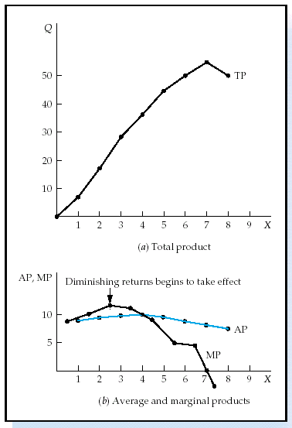
Short-Run Analysis of Total,
Average, and Marginal Product
If MP > AP then AP is rising
If MP < AP then AP is falling
MP = AP when AP is maximized
TP maximized when MP = 0

Slide 18
Three Stages of Production in Short Run
AP,MP
Stage I
Stage III
Stage II
AP_{X}
TP_{L} Increases at increasing rate.
MP Increases at decreasing rate.
AP is increasing and reaches its maximum at the end of stage I
MP_{X}
X
TP_{L} Increases at Diminshing rate.
MP_{L} Begins to decline.
TP reaches maximum level at the end of stage II, MP = 0.
AP_{L} declines
TPL begins to decline
MP becomes negative
AP continues to decline

Slide 19
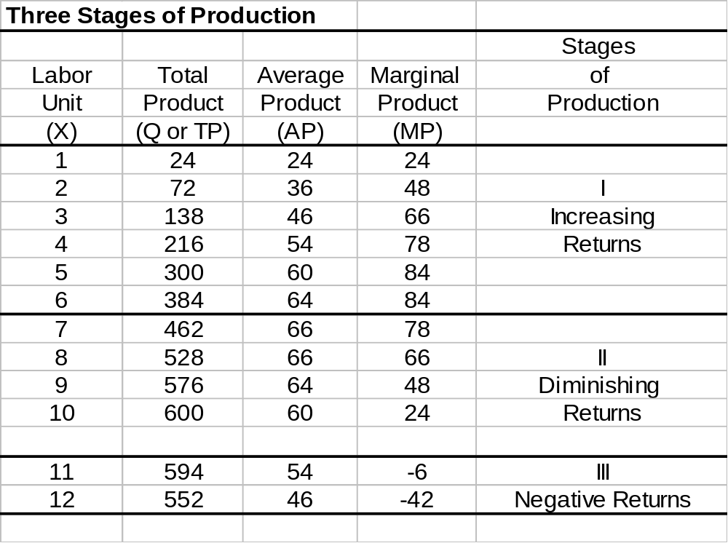

Slide 20
Application of Law of Diminishing Returns:
It helps in identifying the rational and irrational stages of operations.
It gives answers to question –
How much to produce?
What number of workers to apply to a given fixed inputs so that the output is maximum?

Slide 21
Production in the Long-Run
  All inputs are now considered to be variable (both L and K in our case)
  How to determine the optimal combination of inputs?
  To illustrate this case we will use production isoquants.
  An isoquant is a locus of all technically efficient methods or all possible combinations of inputs for producing a given level of output.

Slide 22
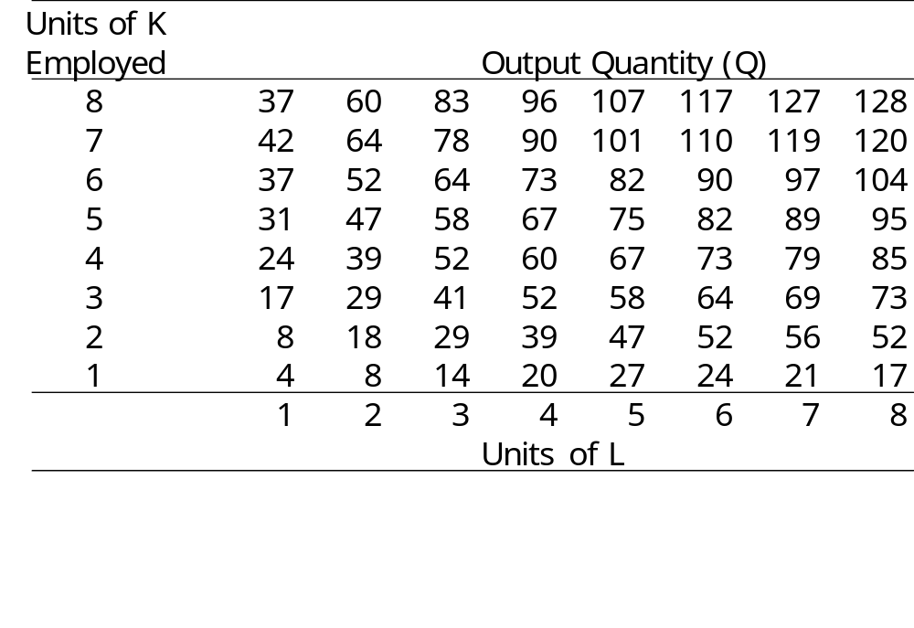
Production Table
Units of K
Employed
Isoquant

Slide 23
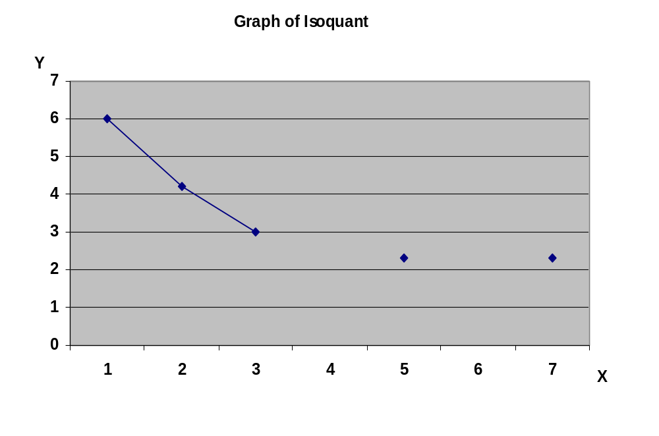
Isoquant

Slide 24
Properties of Isoquants
Isoquants have a negative slope.
Isoquants are convex to the origin.
Isoquants cannot intersect or be tangent to each other.
Upper Isoquants represents higher level of output

Slide 25
Types of Isoquant
There exists some degree of substitutability between inputs.
Different degrees of substitution:
SugarCane
syrup
Natural flavoring
Capital
K₁ K₂ K₃ K₄
Q
Q
Sugar
All other ingredients
L₁ L₂ L₃ L₄
Labor
b) Input – Output/ L-Shaped Isoquant (Perfect complementarity)
c) Kinked/Acitivity
Analysis Isoquant –
(Limited substitutability)
Linear Isoquant (Perfect substitution)

Slide 26
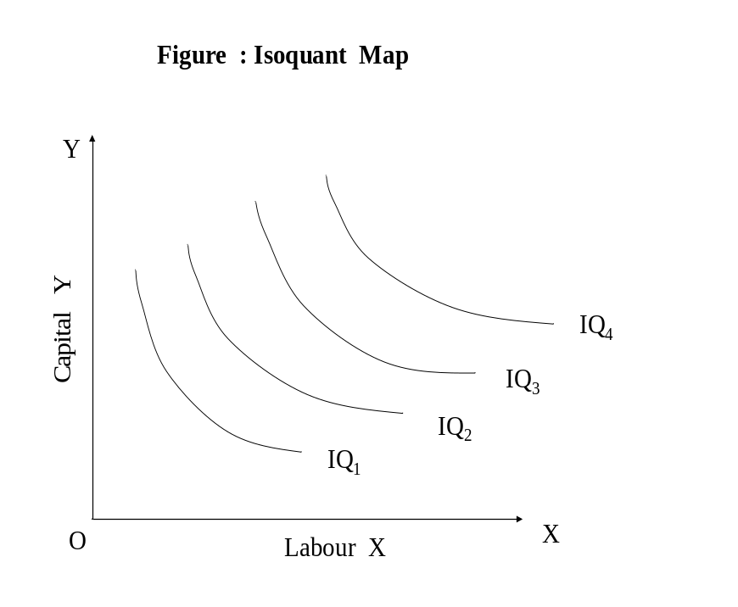
Isoquant Map
Isoquant map is a set of isoquants presented on a two dimensional plain.
Each isoquant shows various combinations of two inputs that can be used to produce a given level of output.

Slide 27
Marginal rate of technical substitution (labor for capital): measures the amount of K the firm the firm could give up in exchange for an additional L, in order to just be able to produce the same output as before.

Slide 28
The marginal rate of technical substitution
The marginal rate of technical substitution, MRTS_{L,K} tells us:
The amount capital can be decreased for every increase in labour, holding output constant OR
The amount capital must be increased for every decrease in labour, holding output constant

Slide 29
Marginal rate of technical substitution
-as we move down the isoquant, the slope decreases, decreasing the MRTS_{L,K}
-this is diminishing marginal rate of technical substitution
as you focus more on one input, the other input becomes more productive
Marginal products and the MRTS (MRTS- Slope of Isoquant)are related:
MP_{L}/MP_{K} = -ΔK/ΔL = MRTS_{L,K}

Slide 30
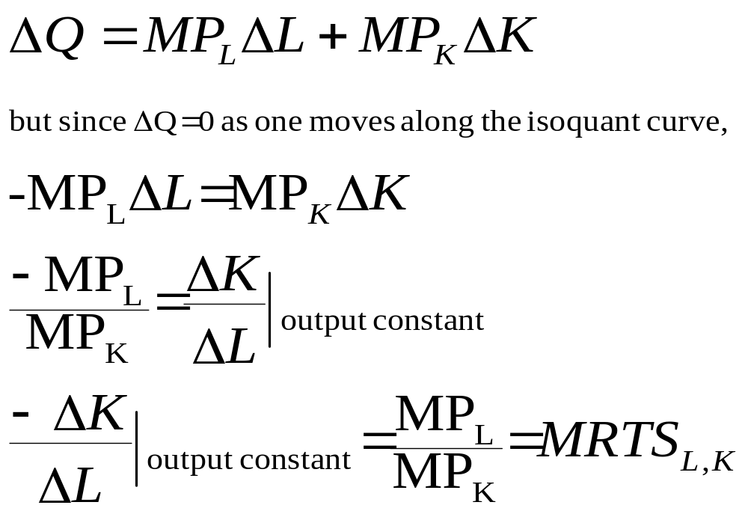
The marginal rate of technical substitution

Slide 31
MRTS Example
Let Q=4LK
MP_{L}=4K
MP_{K}=4L
Find MRTS_{L,K}
MRTS_{L,K} = MP_{L}/MP_{K}
MRTS_{L,K} =4K/4L
MRTS_{L,K} =K/L

Slide 32
How much will output increase when ALL inputs increase by a particular amount?
RTS = [%ΔQ] / [%Δ(all inputs)]
Laws of Returns to Scale
1% increase in inputs => more than 1% increase in output, increasing returns to scale.
1% increase in inputs => 1% increase in output
constant returns to scale.
1% increase in inputs => a less than 1% increase in output, decreasing returns to scale.

Slide 33
Increasing RTS
K
Product Line
3K
3X
2K
2X
K
X
0
L
2L
3L
L

Slide 34
Increasing RTS
If all inputs are doubled, output will also increase at the faster rate that double
Reasons
Division of labour
Specialization
External economies of scale
Technical and managerial indivisibilities
Higher degree of specialization
Dimensional relations

Slide 35
Constant RTS
K
Product Line
3K
3X
2K
2X
K
X
0
L
2L
3L
L

Slide 36
Constant RTS
If all inputs are doubled, output will also doubled
Reasons
Economics of scale is balanced by diseconomies of scale.
Indivisibility of fixed factors
When the factors of production are perfectly divisible, the production function is homogenous of degree 1 showing constant returns of scale.
For example, a function is homogeneous of degree 1 if, when all its arguments are multiplied by any number t > 0, the value of the function is multiplied by the same number t.

Slide 37
Decreasing RTS
K
Product Line
3K
3X
2K
2X
K
X
0
L
2L
3L
L

Slide 38
Returns To Scale
Why are returns to scale important?
If an industry faces DECREASING returns to scale, small factories make sense
  -It is easier to have small firms in this industry
  If an industry faces INCREASING returns to scale, large factories make sense
  -Large firms have an advantage; natural monopolies

Slide 39
Notes
The marginal product of a single factor may diminish while the returns to scale do not
Marginal product deals with a SINGLE input increasing, while returns to scale deals with MULTIPLE inputs increasing
Returns to scale need not be the same at different levels of production

Slide 40
CHAPTER FOUR
SHORT-RUN COST AND LONGRUN COST

Slide 41
Learning Objectives
Why economic costs include both explicit costs and implicit costs.
How the law of diminishing returns relates to a firm’s short-run production costs.
Distinctions between fixed and variable costs and among total, average, and marginal costs.
The link between a firm’s size and its average costs in the long run.

Slide 42
Economic Costs
Economic costs - payments a firm must make, or incomes it must provide, to resource suppliers to attract those resources away from their best alternative production opportunities. Payments may be explicit or implicit.
Explicit Costs
Cash Payments a firm makes to those who supply labor services, materials, fuel, transportation services, etc.
Money payments are for the use of resources owned by others.

Slide 43
Implicit Costs
Implicit costs - opportunity costs of using its self-owned, self-employed resources.
Money payments that self-employed resources could have earned in their best alternative use
Forgone interest, forgone rent, forgone wages, and forgone entrepreneurial income.

Slide 44
Short Run
Time period that is too brief for a firm to alter its plant capacity. The plant size is fixed in the short run.
Short‑run costs, then, are the wages, raw materials, etc., used for production in a fixed plant.

Slide 45
Short-Run Production Costs
To produce more output in the short run, a firm employ more labor, which means it must increase its costs.
We describe the relationship between output and cost using three cost concepts:
Total cost
Average cost
Marginal cost

Slide 46
SHORT-RUN COST
Total Cost
A firm’s total cost (TC) is the cost of all the factors of production the firm uses.
Total cost divides into two parts:
Total fixed cost (TFC) is the cost of a firm’s fixed factors of production used by a firm —the cost of land, capital, and entrepreneurship.
Total fixed cost doesn’t change as output changes.

Slide 47
SHORT-RUN COST
Total variable cost (TVC) is the cost of the variable factor of production used by a firm —the cost of labor.
To change its output in the short run, a firm must change the quantity of labor it employs, so total variable cost changes as output changes.
Total cost is the sum of total fixed cost and total variable cost. That is,
TC = TFC + TVC

Slide 48
SHORT-RUN COST
Labor | Quantity | Fixed Cost | Variable Cost | Total Cost
1 | 16 | $160 | $80 | $240
2 | 40 | $160 | $160 | $320
3 | 60 | $160 | $240 | $400
4 | 72 | $160 | $320 | $480
5 | 80 | $160 | $400 | $560
6 | 84 | $160 | $480 | $640
7 | 82 | $160 | $560 | $720

Slide 49
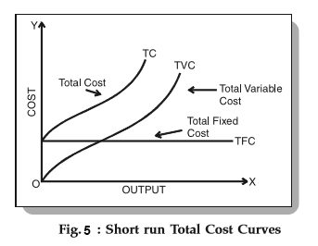
SHORT-RUN COST
Total fixed cost (TFC) is
constant—it graphs as a
horizontal line.
Total variable cost (TVC)
increases as output increases.
Total cost (TC) also
increases as output increases.

Slide 50
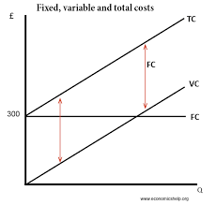
SHORT-RUN COST
The vertical distance between the total cost curve and the total variable cost curve is total fixed cost, as illustrated by the two arrows.

Slide 51
SHORT-RUN COST
Marginal cost
Marginal cost - additional cost of producing one more unit of output (MC = change in TC/change in Q).
Marginal cost tells us how total cost changes as total product changes.

Slide 52
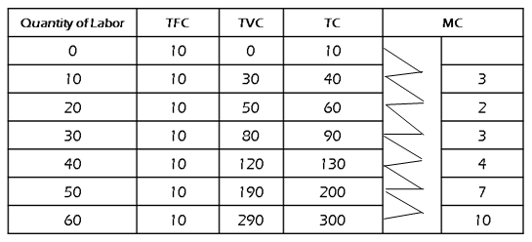
SHORT-RUN COST

Slide 53
SHORT-RUN COST
Average Cost OR Per unit
There are three average cost concepts:
  Average fixed cost (AFC) is the total fixed cost divided by the level of output (TFC/Q). It will decline as output rises.
Average variable cost (AVC) is the total variable cost divided by the level of output (AVC = TVC/Q).
Average total cost (ATC) is the total cost divided by the level of output (ATC = TC/Q), sometimes called unit cost or per unit cost. Note that ATC also equals AFC + AVC

Slide 54
Examples
L | Q | MP | VC | AVC | FC | AFC | TC | AC | MC
0 | 0 | - | 0 | - | 30 | - | 30 | - | -
1 | 60 | 60 | 10 | 0.17 | 30 | 0.57 | 40 | 0.67 | 0.17
2 | 110 | 50 | 20 | 0.18 | 30 | 0.27 | 50 | 0.45 | 0.20
3 | 150 | 40 | 30 | 0.20 | 30 | 0.20 | 60 | 0.40 | 0.25
4 | 180 | 30 | 40 | 0.22 | 30 | 0.17 | 70 | 0.39 | 0.33
5 | 200 | 20 | 50 | 0.25 | 30 | 0.15 | 80 | 0.40 | 0.50
6 | 210 | 10 | 60 | 0.29 | 30 | 0.14 | 90 | 0.43 | 1.00

Slide 55
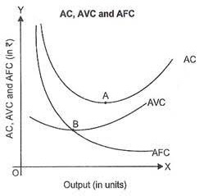
SHORT-RUN COST
Average fixed cost (AFC) decreases as output increases.
The average variable cost curve (AVC) is U-shaped.
The average total cost curve (ATC) is also U-shaped

Slide 56
SHORT-RUN COST
The vertical distance between these two curves is equal to average fixed cost
The marginal cost curve (MC) is U-shaped and intersects the average variable cost curve and the average total cost curve at their minimum points

Slide 57
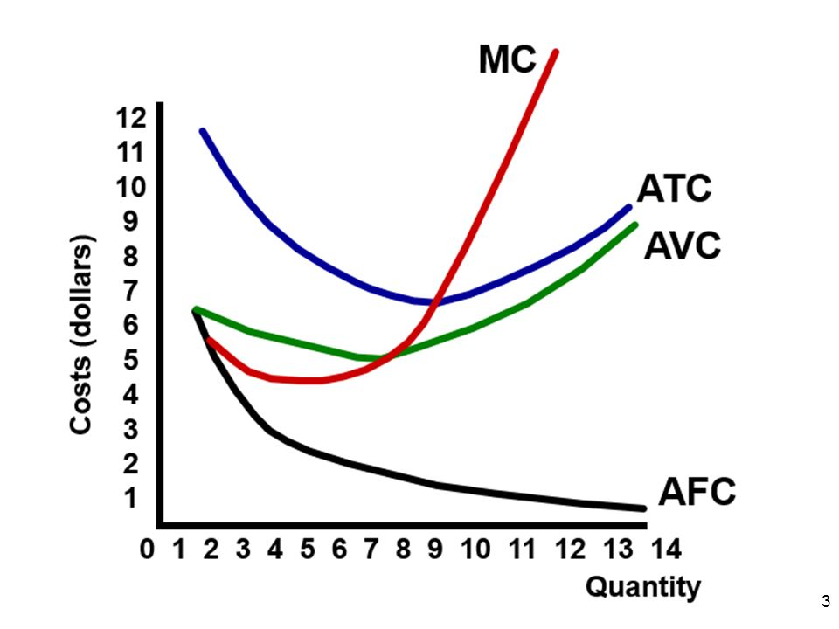

Slide 58
SHORT-RUN COST
Why the Average Total Cost Curve Is U- Shaped
Average total cost, ATC, is the sum of average fixed cost, AFC, and average variable cost, AVC.
The shape of the ATC curve combines the shapes of the AFC and AVC curves.
The U shape of the average total cost curve arises from the influence of two opposing forces:
Spreading total fixed cost over a larger output
Decreasing marginal returns

Slide 59
Cost Curves and Product Curves
The technology that a firm uses determines its costs.
At low levels of employment and output, as the firm hires more labor, marginal product
and average product rise, and marginal cost and average variable cost fall.
Then, at the point of maximum marginal product, marginal cost is a minimum.
As the firm hires more labor, marginal product decreases and marginal cost increases.

Slide 60
But average product continues to rises, and average variable cost continues to fall.
Then, at the point of maximum average product, average variable cost is a minimum.
As the firm hires even more labor, average product decreases and average variable cost increases. A firm’s marginal cost curve is linked to its marginal product curve.
If marginal product rises, marginal cost falls.
If marginal product is a maximum, marginal cost is a minimum.

Slide 61
Graph the relationship between the product curves and cost curves.
A firm’s average variable cost curve is linked to its average product curve.
If average product rises, average variable cost falls.
If average product is a maximum, average variable cost is a minimum.

Slide 62
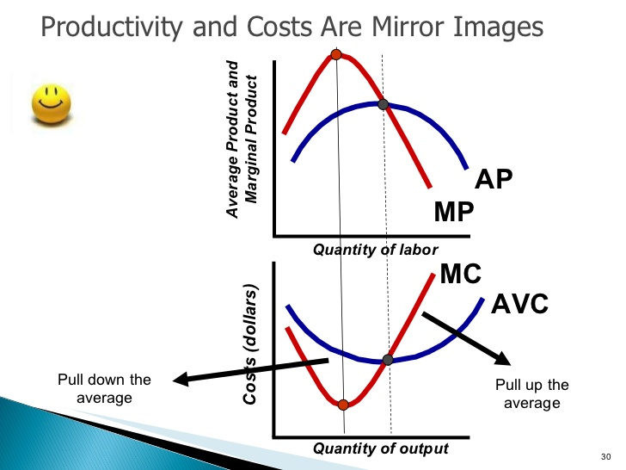

Slide 63
At low outputs, MP and AP rise and MC and AVC fall.
At intermediate outputs, MP falls and MC rises; and AP rises and AVC falls.
At high outputs, MP and AP fall and MC and AVC rise.

Slide 64
Shifts in Cost Curves
Technology
A technological change that increases productivity shifts the total product curve upward.
It also shifts the marginal product curve and the average product curve upward.
With a better technology, the same inputs can produce more output, so an advance in technology lowers the average and marginal costs and shifts the short-run cost curves downward.

Slide 65
Shifts in Cost Curves
Prices of Factors of Production
An increase in the price of a factor of production increases costs and shifts the cost curves.
But how the curves shift depends on which resource price changes.
A change in rent or some other component of fixed cost shifts the fixed cost curves (TFC and AFC) upward and shifts the total cost curve (TC) upward but leaves the variable cost curves (AVC and TVC) and the marginal cost curve (MC) unchanged.

Slide 66
Shifts in Cost Curves
A change in wage rates or some other component of variable cost shifts the variable curves (TVC and AVC) and the marginal cost curve (MC) upward but leaves the fixed cost curves (AFC and TFC) unchanged.

Slide 67
Shifts in Cost Curves
Plant Size and Cost
When a firm changes its plant size, its cost of producing a given output changes.

Slide 68
long run COST
The long run is a period of time long enough for a firm to change the quantities of all resources employed, including the plant size.
Long‑run costs are all costs, including the cost of varying the size of the production plant.

Slide 69
Costs in the long run
in the long run all factors are assumed to become variable.
In the long run the firm can change the quantities of all inputs including the size of the plant.
This implies that all costs are variable in the long-run in the sense that it is always possible to produce zero units of output at zero costs.
That is, it is always possible to go out of business.
The long–run cost curve is a planning curve, in the sense that it is a guide to the entrepreneur in his decision to plan the future expansion of his plant.

Slide 70
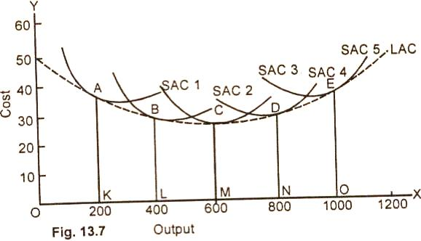
LONG- RUN COST
In the diagram above given above, there are five alternative scales of plant SAC¹ SAC², SAC³, SAC⁴ and, SAC⁵. In the long run, the firm will operate the scale of plant which is most profitable to it.

Slide 71
For example, if the anticipated rate of output is 200 units per unit of time, the firm will choose the smallest plant It will build the scale of plant given by SAC¹ and operate it at point A.
This is because of the fact that at the output of 200 units, the cost per unit is lowest with the plant size 1 which is the smallest of all the four plants.

Slide 72
In case, the volume of sales expands to 400, units, the size of the plant will be increased and the desired output will be attained by the scale of plant represented by SAC² at point B, If the anticipated output rate is 600 units, the firm will build the size of plant given by SAC³ and operate it at point C where the average cost is $26 and also the lowest The optimum output of the firm is obtained at point C on the medium size plant SAC³.

Slide 73
If the anticipated output rate is 1000 per unit of time the firm would build the scale of plant given by SAC⁵ and operate it at point E.
If we draw a tangent to each of the short run cost curves, we get the long average cost (LAC) curve. The LAC is U-shaped but is flatter than tile short run cost curves.
Mathematically expressed, the long-run average cost curve is the envelope of the SAC curves.
In the above figure, the long-run average cost curve of the firm is lowest at point C.
CM is the minimum cost at which optimum output OM can be, obtained.

Slide 74
Why is the LAC U-shaped?
Similar to the SAC curve, the LAC curve of a firm is also U-shaped, but the reason for the U-shapes ness of LAC curve is different from that of the SAC curve.
The LAC curve is U-shaped due to the laws of returns to scale(i.e increasing and decreasing returns to scale)
that is, as output expands from a very low levels increasing returns to scale prevails (i.e., output rises proportionally more than inputs), and so the cost per-unit of output falls(assuming that input prices remain constant).

Slide 75
As output continues expand, the forces of decreasing returns to scale eventually begin to overtake the forces of increasing returns to scale and the LAC begins to rise.
the reason for the U-shapedness of the LAC curve are the existence of increasing returns to scale at initial stage of expansion decreasing returns to scale at a later stage of expansion.

Slide 76
The long-run marginal cost curve.
The long-run marginal cost curve (LMC) is derived from the short run MC curve but does not envelope them.
The LMC is formed from points of intersection of the SMC curves with the vertical lines (to the x-axis) drawn from the points of tangency of corresponding SAC curves and the LAC curve.

Slide 77
GRAPH

Slide 78
The long-run marginal cost curve
Note that, the LMC curve passes through the minimum of the LAC curve.

